Slide 1
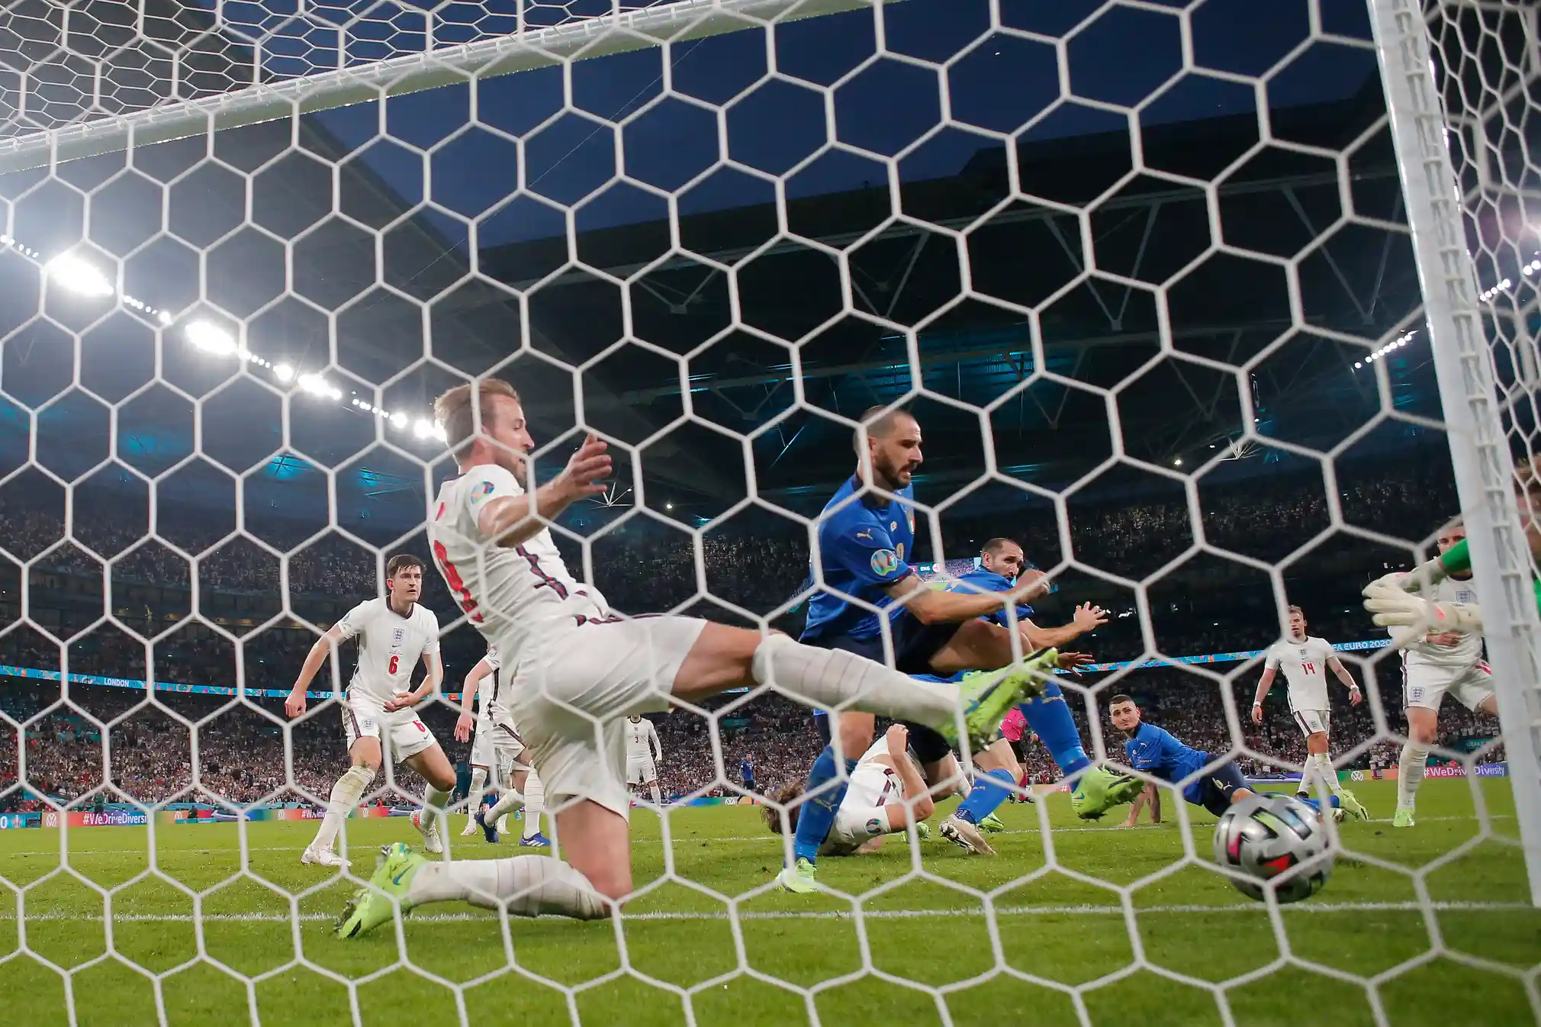
Patterns of Play that Created Delayed Shot Opportunities in Corner Sequences
Arden Holden
Italy’s goal from a corner against England in the final of the 2020 EURO
Photograph: Tom Jenkins/The Guardian

Slide 2
Introduction & Background
Of the 461 corners taken at the EURO, 177 produced a shot in the sequence following the corner.
This project focuses on the shot opportunities that were delayed, or created 10 seconds or later after the corner was taken.
There were 34 corners that resulted in delayed opportunities.
England had the most delayed opportunities with 6. Italy and Spain were second with 4. All three teams were in the top five teams of average xG on delayed opportunities.

Slide 3
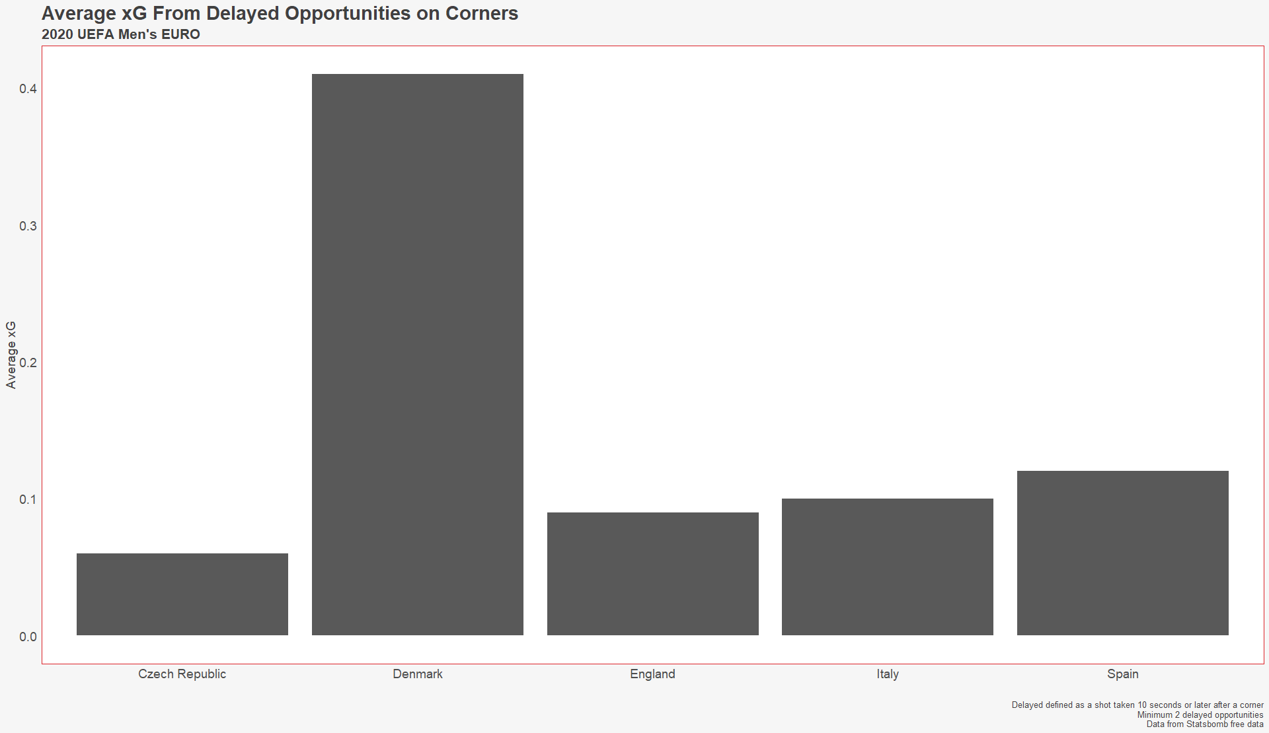
Average xG From Delayed Opportunities

Slide 4
Five Patterns of Play that Created Delayed Opportunities
Playing vertical through defensive lines that were pushing up
Passing/switching the field to shift the defense away from space that would eventually be exploited
Exploiting the narrowness of the defense after a corner
Exploiting the disorganization of the defense after a corner
Taking advantage of space afforded around the box because the defense was pinned back

Slide 5
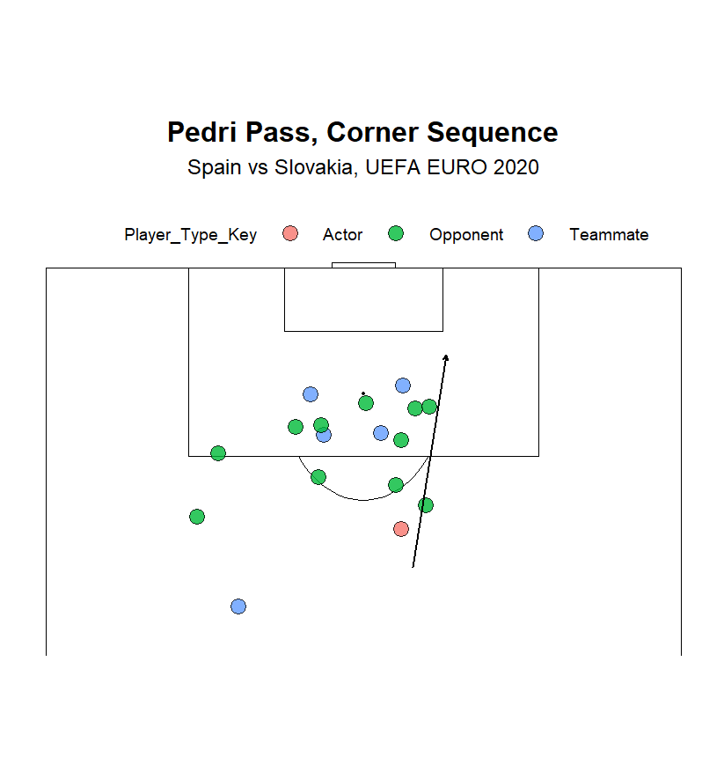
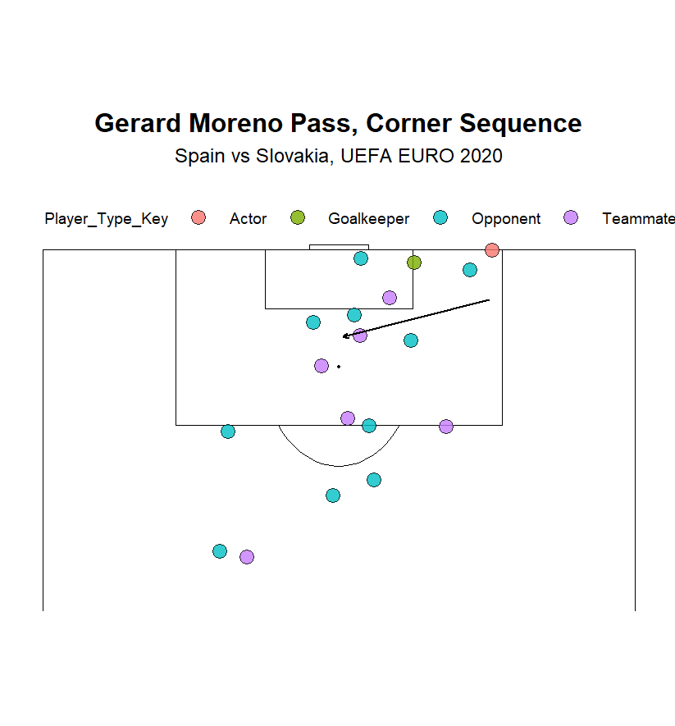
Playing Vertical – Spain vs Slovakia

Slide 6
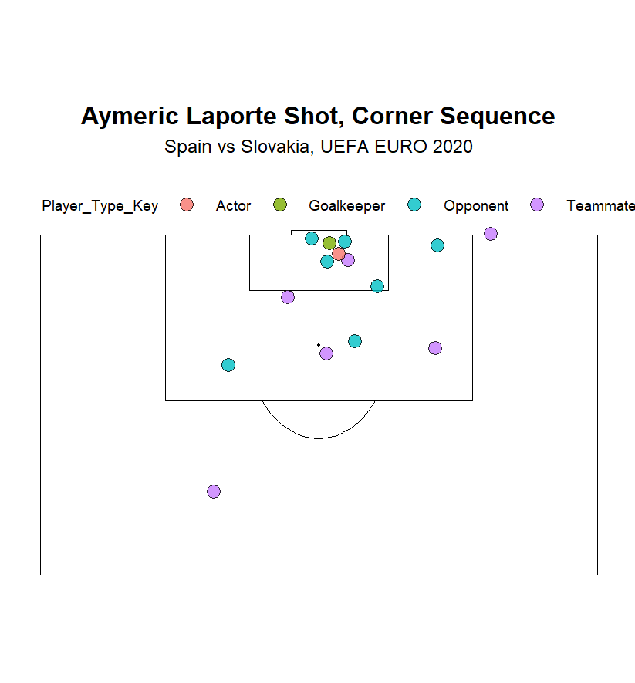
Playing Vertical – Spain vs Slovakia

Slide 7
Playing Vertical Implementation
Encourage players to constantly be looking for line breaking options when defenses are pushing up.
Players off the ball should be directed to make runs in the seams between defenders, or to place themselves in a position where they can break lines by passing or carrying.

Slide 8
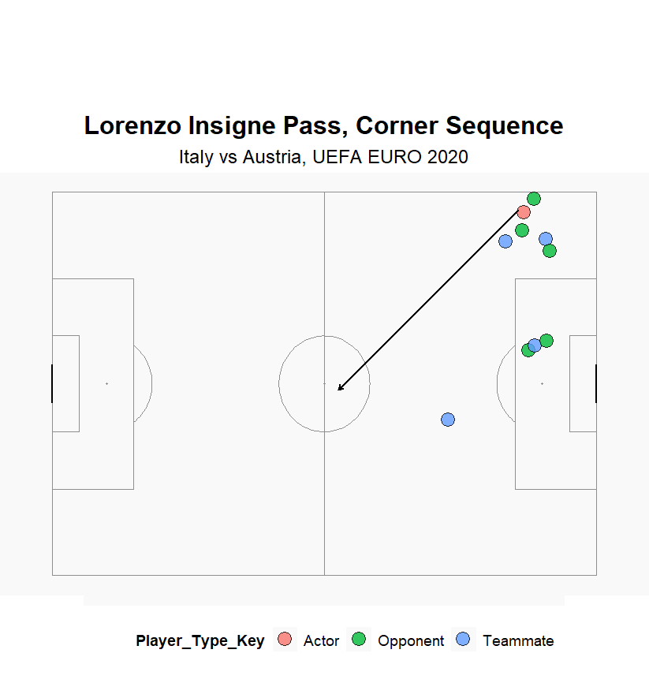
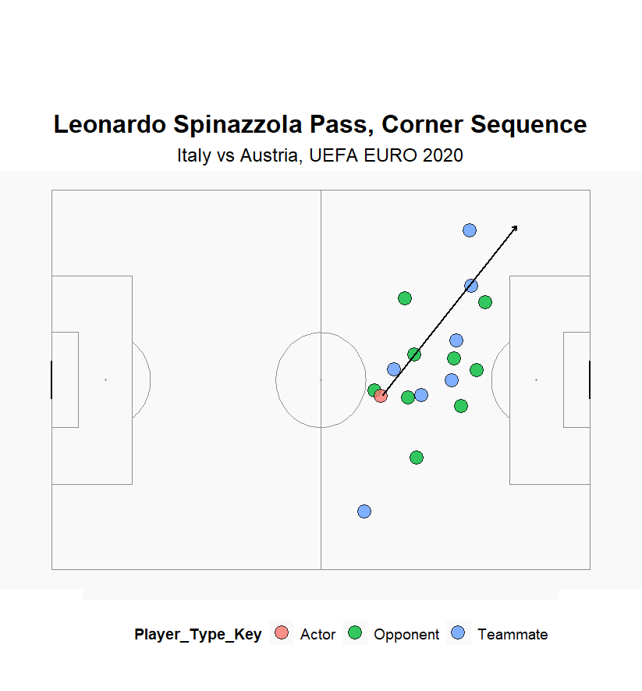
Switching the Field – Italy vs Austria

Slide 9
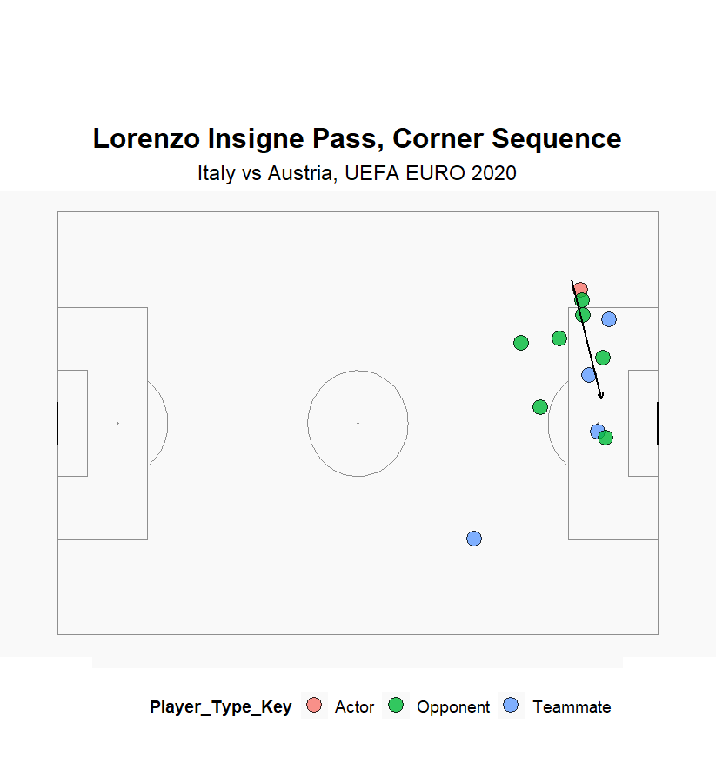
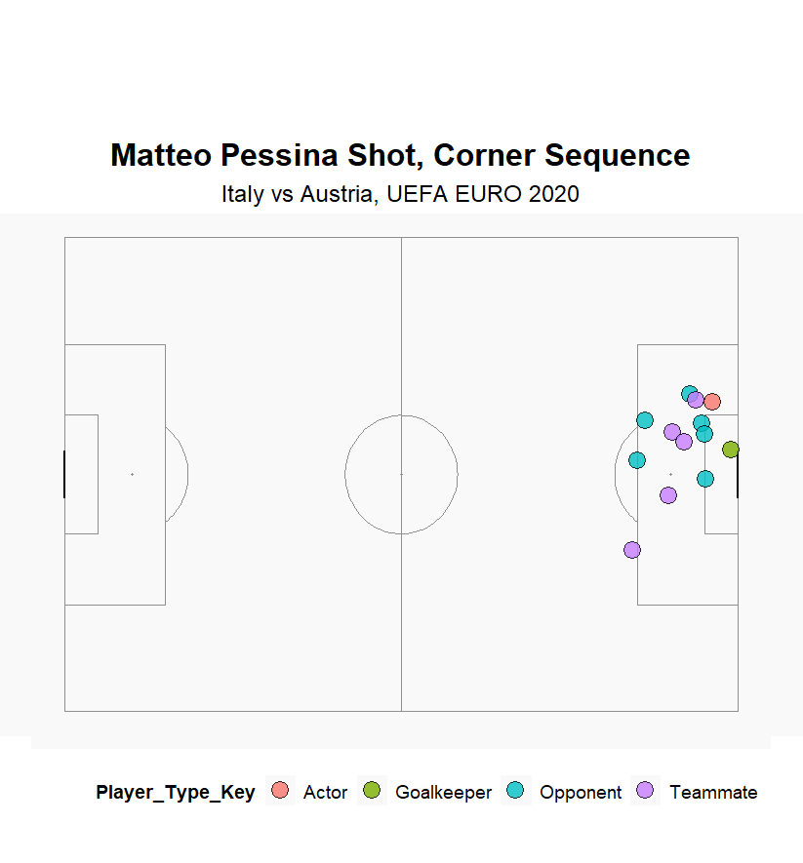
Switching the Field – Italy vs Austria

Slide 10
Switching the Field Implementation
Utilizing patterns in training that mimic shifting teams away from an area in order to later exploit that area can give players a better idea of how to do it within the team’s framework.
Showing examples in film would be useful.
On an individual level, encouraging players to use their body shape (the direction their body is facing and the orientation of their body to appear like they are going to perform a certain action, such as a shot or a pass) will also aid in shifting defenders.

Slide 11
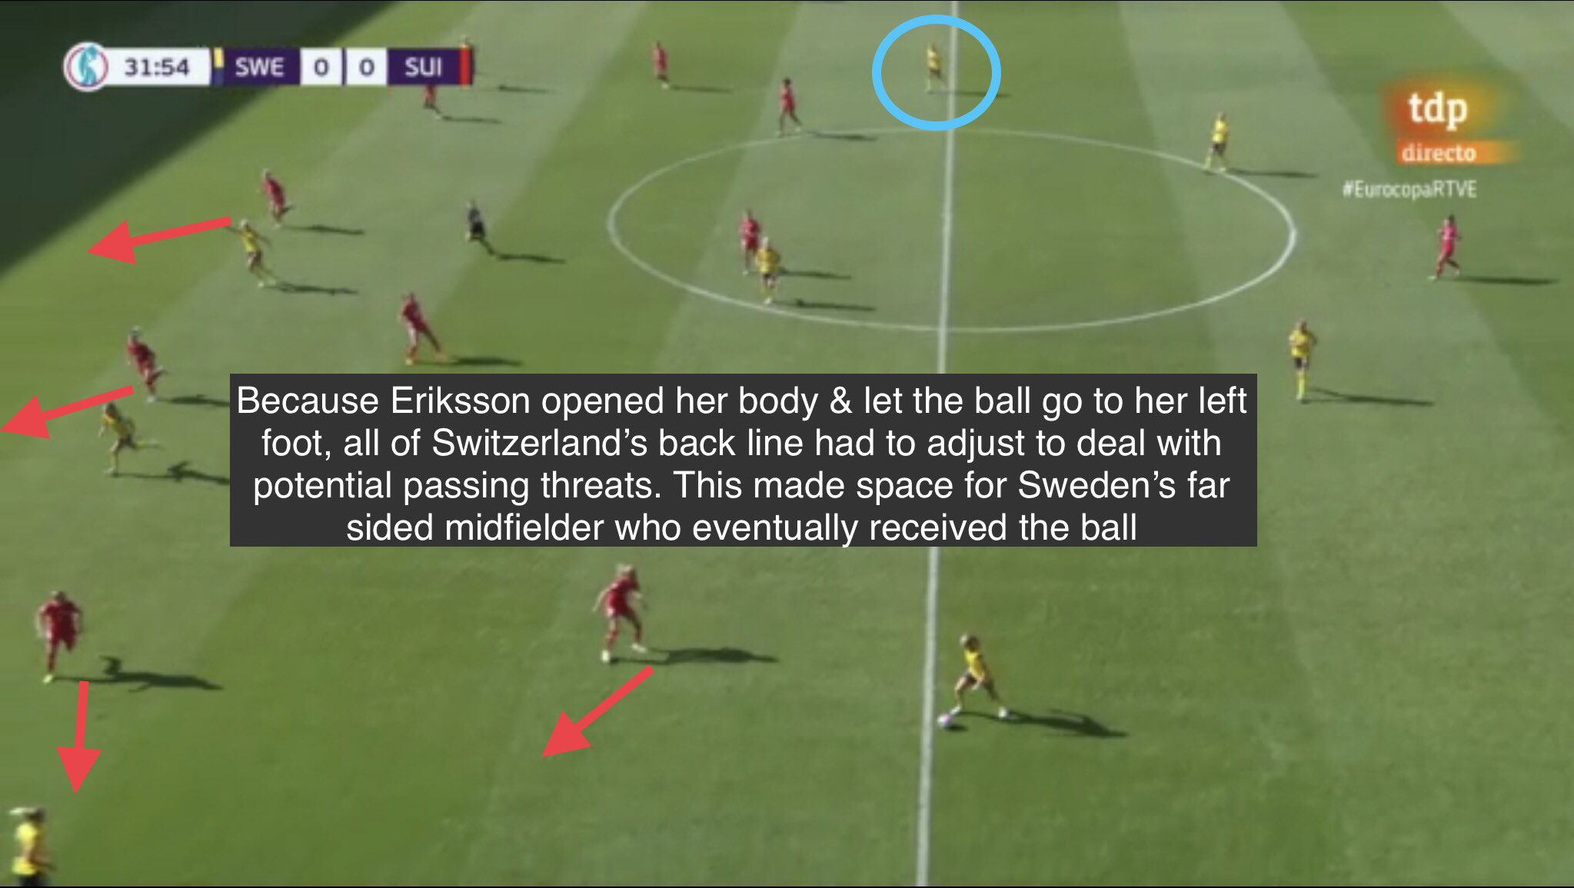
Example of How Body Shape Can Shift Defenses

Slide 12
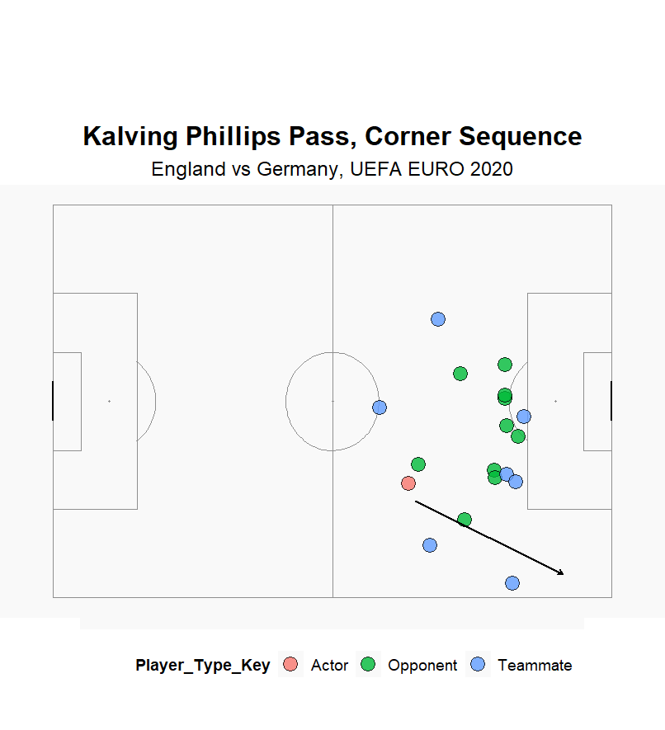
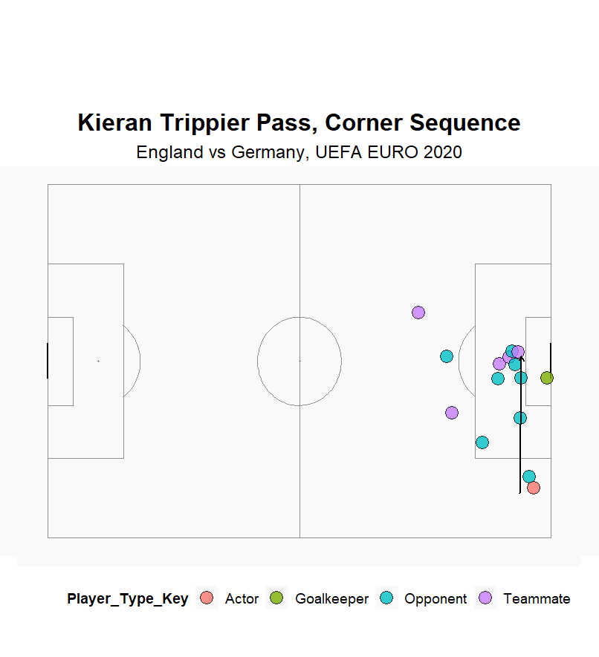
Exploiting Narrowness – England vs Germany

Slide 13
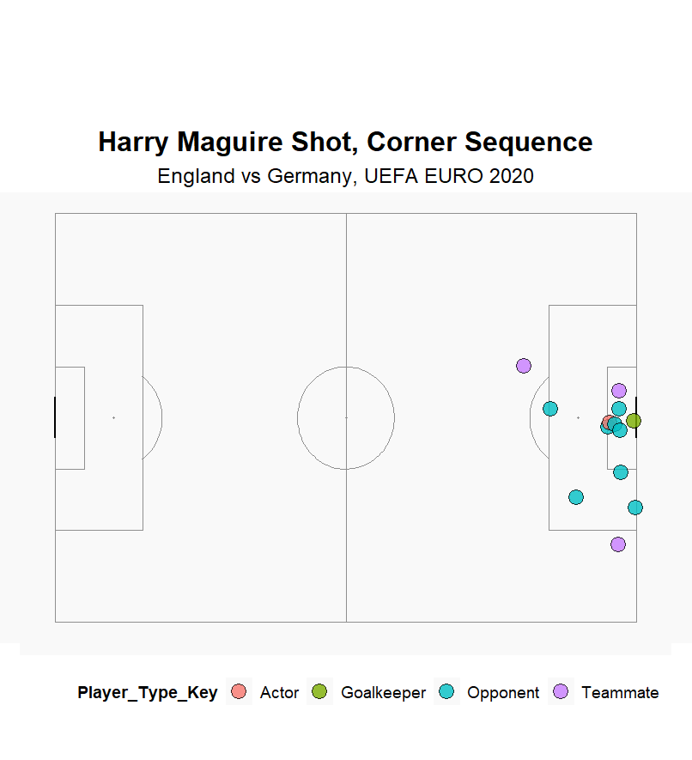
Exploiting Narrowness – England vs Germany

Slide 14
Exploiting Narrowness Implementation
Training drills specific to creating a game like situation where the defense is narrow while pushing up can give players better recognition of the situation as it happens.

Slide 15
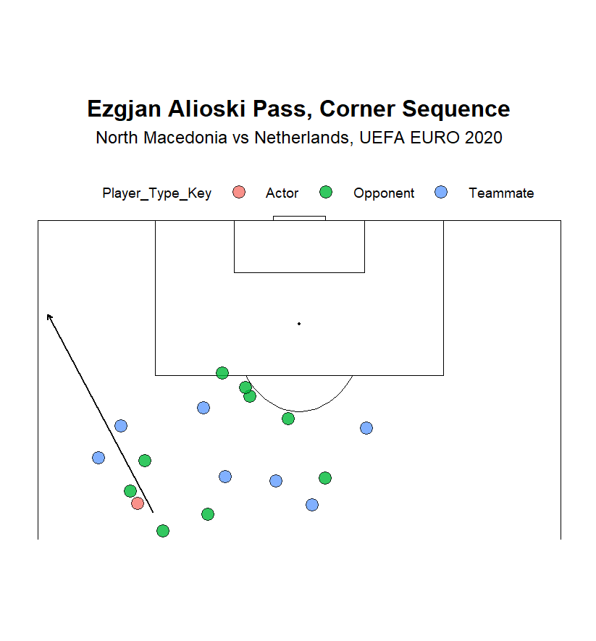
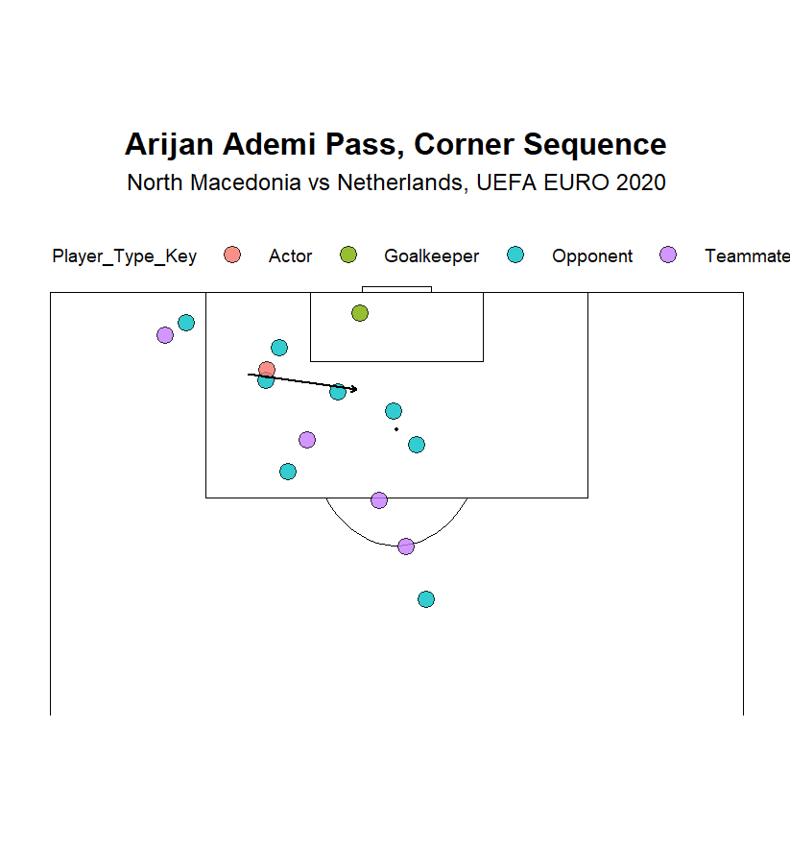
Exploiting Disorganization – North Macedonia vs Netherlands

Slide 16
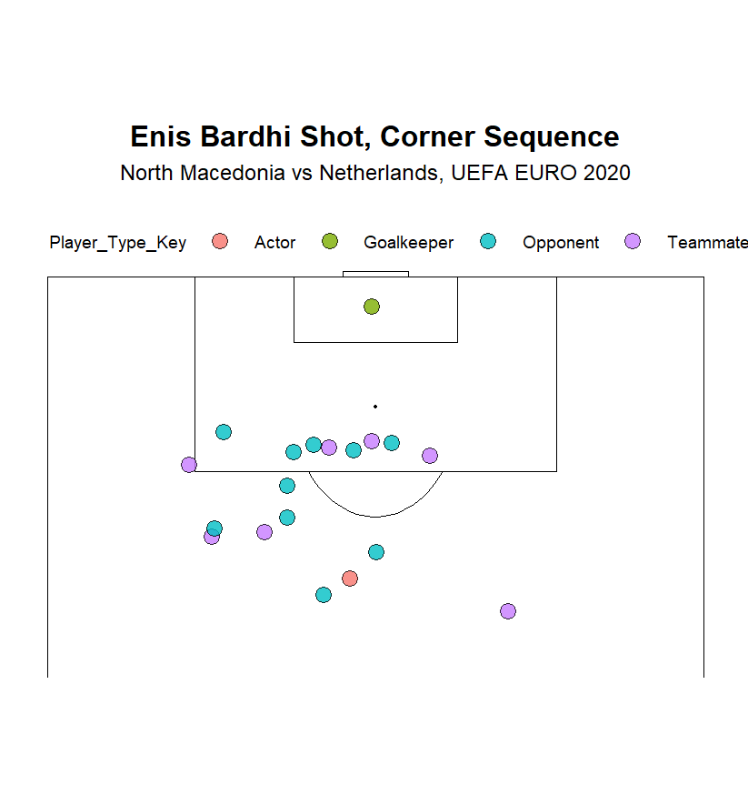
Exploiting Disorganization – North Macedonia vs Netherlands

Slide 17
Exploiting Disorganization Implementation
Like the implementation for narrowness, specific drills in training that create a game like situation where the defense is disorganized while pushing up can give players better recognition of the situation as it happens.

Slide 18
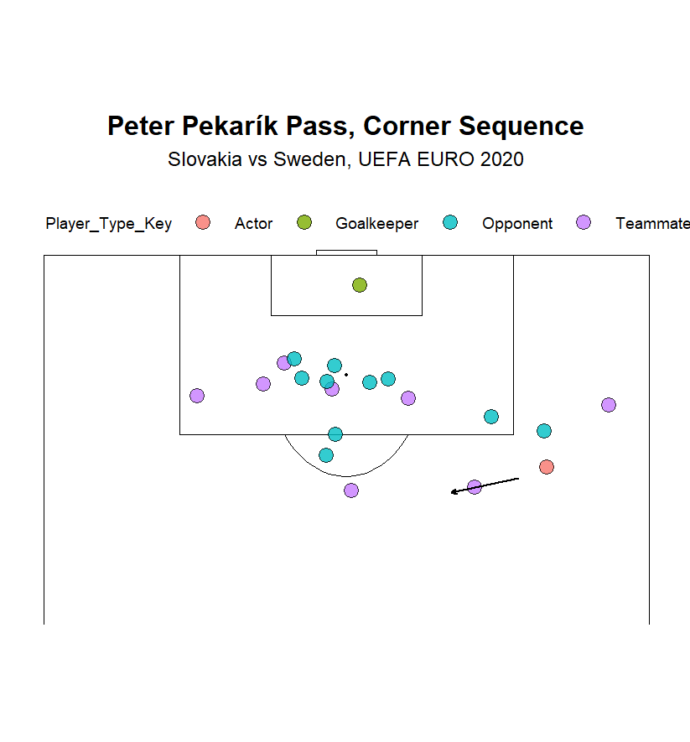
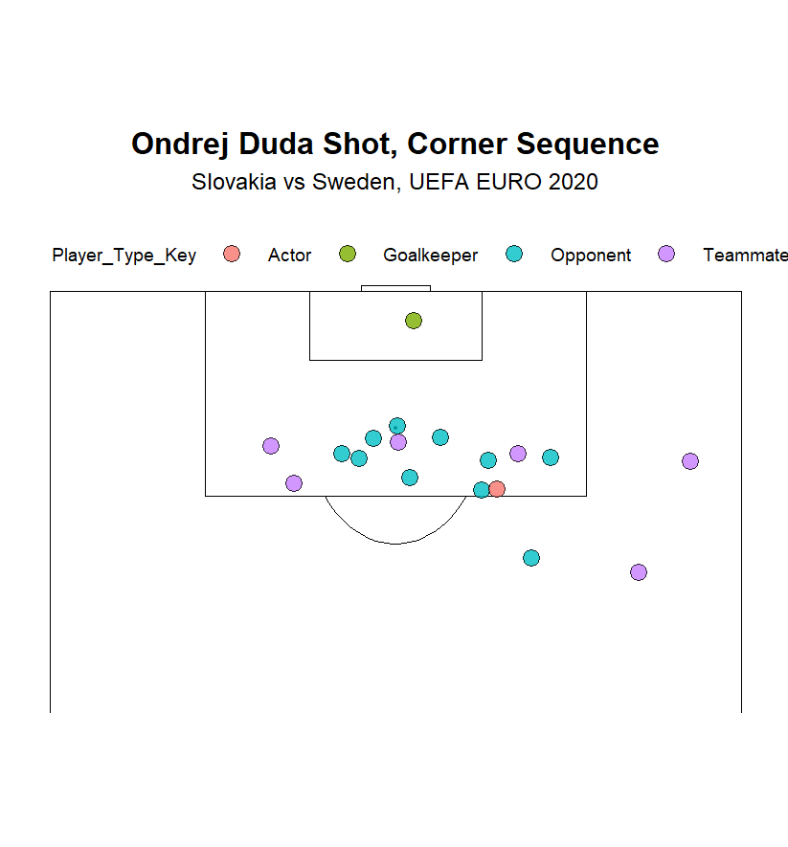
Exploiting Space Around the Box – Slovakia vs Sweden

Slide 19
Exploiting Space Around the Box Implementation
Film sessions with examples would give players a good grasp of this concept.
It’s also important to differentiate to the players the difference between shots and passes that can cause havoc due to dense numbers and shots and passes that are made out of desperation or without much thought.

